Slide 1
Stevie’s most troubling time with R: Summarising Data

Slide 2
Context
COVID-19 European Patient Registry
Online survey of people with rheumatic diseases from March 2020
Variables largely coded using strings
Task: To describe characteristics of people with and without COVID-19

Slide 3
Packages required
library(tidyverse)
library(dplyr)

Slide 4
First task: code up variables of interest
Destring variables that are actually numeric:
COVID19EPR$age <- as.numeric(as.character(COVID19EPR$age))

Slide 5
First task: code up variables of interest
Recode variables from missing to 0 where you are sure lack of response = 0:
falseifNA <- function(x){
ifelse(is.na(x), FALSE, x)
}
COVID19EPR <- COVID19EPR %>% mutate(social_distance = ifelse(falseifNA(COVIDPROTECT_DISTANCING=="DISTANCING"),1,0))

Slide 6
First task: code up variables of interest
2. Categorise variables with clinically meaningful thresholds
COVID19EPR <- COVID19EPR %>%
mutate(bmi_cat = ifelse(BMI>0 & BMI<18.5, "<18.5",
ifelse(BMI>=18.5 & BMI<25, "18.5-25",
ifelse(BMI>=25 & BMI<30, "25-30",
ifelse(BMI>=30 & BMI<35,"30-35",
ifelse(BMI>=35 & BMI<40, "35-40",
ifelse(!is.na(BMI),"40+", NA)))))))

Slide 7
First task: code up variables of interest
3. Change categorical variables to only have categories with >10 people in each (for confidentiality purposes):
table(COVID19EPR$COUNTRY)
COVID19EPR <- COVID19EPR %>%
mutate(country_cat = ifelse(COUNTRY == "France", "France",
ifelse(COUNTRY == "Greece", "Greece",
ifelse(COUNTRY=="Ireland", "Ireland",
ifelse(COUNTRY=="Italy", "Italy",
ifelse(COUNTRY=="Netherlands", "Netherlands",
ifelse(COUNTRY=="Slovenia", "Slovenia",
ifelse(COUNTRY=="Spain", "Spain",
ifelse(COUNTRY=="Sweden", "Sweden",
ifelse(COUNTRY=="United Kingdom (UK)", "UK",
ifelse(COUNTRY=="USA", "USA", "Other")))))))))))

Slide 8
Drop people not interested in
Dropping people without a rheumatic disease:
COVID19EPR <- COVID19EPR %>% filter(DIAGNOSIS_GROUP!="NONE")

Slide 9
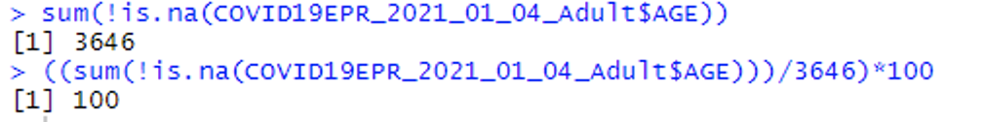
How much missing data for each variable in the baseline table
sum(!is.na(COVID19EPR$AGE))
((sum(!is.na(COVID19EPR$AGE)))/3646)*100

Slide 10
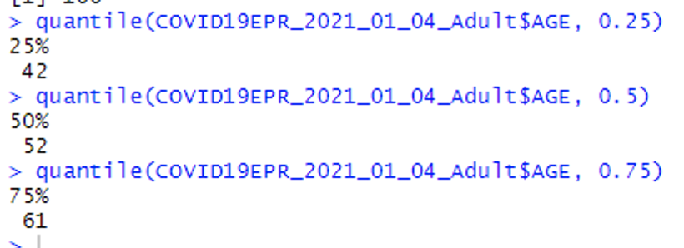
Describe characteristics of whole cohort
Continuous variables (median, IQR):
quantile(COVID19EPR$age,0.25)
quantile(COVID19EPR$age,0.5)
quantile(COVID19EPR$age,0.75)

Slide 11
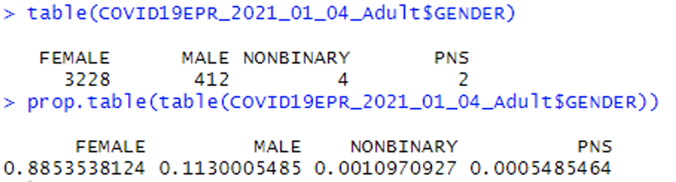
Describe characteristics of whole cohort
Categorical variables (N, %):
table(COVID19EPR$GENDER)
prop.table(table(COVID19EPR$GENDER))

Slide 12
Comparing COVID vs no COVID
First, I have created 2 new datasets – one filtered for COVID and one for No COVID:
covid <- COVID19EPR %>% filter(COVID_EVER=="YES")
no_covid <- COVID19EPR %>% filter(COVID_EVER=="NO")

Slide 13
Comparing COVID vs no COVID
Summarising continuous vars using these new datasets
quantile(covid$age,0.25)
quantile(covid$age,0.5)
quantile(covid$age,0.75)
quantile(no_covid$age,0.25)
quantile(no_covid$age,0.5)
quantile(no_covid$age,0.75)

Slide 14
Comparing COVID vs no COVID
Summarising categorical vars in original dataset
(tbl <- table(COVID19EPR$DIAGNOSIS_GROUP, COVID19EPR$COVID_EVER))
prop.table(table(COVID19EPR$DIAGNOSIS_GROUP, COVID19EPR$COVID_EVER), 2)

Slide 15
Univariable stats to compare
Chi-squared and Fisher’s exact test
(tbl <- table(COVID19EPR$DIAGNOSIS_GROUP, COVID19EPR$COVID_EVER))
chisq.test(tbl)
fisher.test(tbl)
Pro in R (?!): an error will pop up telling you if Chi-squared is not a good estimator for your data

Slide 16
Univariable stats to compare
Mann-Whitney U-test
wilcox.test(COVID19EPR$age ~ COVID19EPR$COVID_EVER)

Slide 17
Things I use regularly in Stata for baseline tables that I would love to know how to do in R
Count the number of people with available/missing data for a variable/at a given time point in a single command
LOOPS. Looping over multiple named variables that aren’t next to each other in a dataset with the same summary command.
There seem to be MANY ways to do this, and I have accomplished failure for Every. Single. One.
Summarise multiple statistics e.g. median (IQR) or N (%) using a single command

